Slide 1
UNIT 1: NumPy for Numerical Computing (Lecture 5)

Slide 2
NumPy:
NumPy (Numerical Python)
Used for numerical computing in Python
Efficient handling of arrays & matrices

Slide 3
NumPy Arrays:
A powerful n-dimensional data container, similar to lists but optimized for speed.

Slide 4
Why NumPy?
Faster than Python lists
Supports multi-dimensional arrays
Used in ML, Data Science, AI

Slide 5
NumPy Arrays:
Homogeneous data type
Stored in contiguous memory
ndarray is core object

Slide 6
Creating Arrays:
array()
→ a = np.array([1, 2, 3, 4])
arange()
→ np.arange(0, 10, 2)
zeros(), ones()
np.zeros(5), np.zeros((2, 3)), np.ones((3, 2))
full()
→ np.full((3, 2), 7)
linspace(): Creates evenly spaced values between a range.
np.linspace(0, 1, 5)
eye:
np.eye(4)

Slide 7
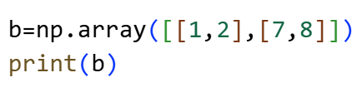
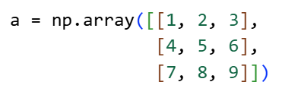
2D array and 3D array:

Slide 8
Method | Purpose
array() | Convert list to array
arange() | Range-based values
zeros() | Initialize with 0
ones() | Initialize with 1
full() | Constant value
linspace() | Equal spacing
eye() | Identity matrix

Slide 9
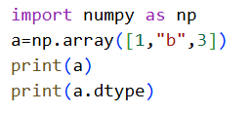
Task:

Slide 10
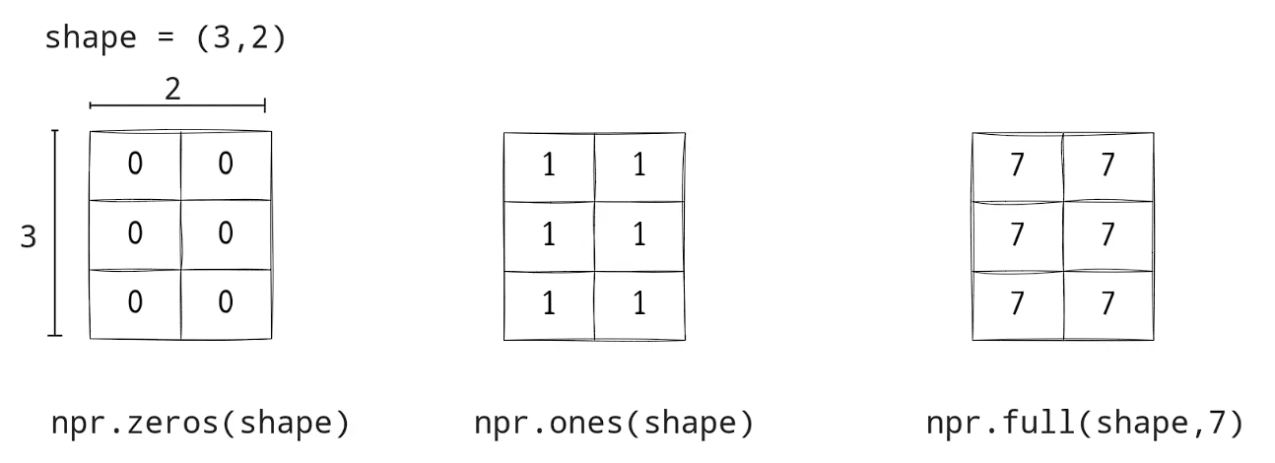
N-Dimensional Array:

Slide 11
Array Properties:
ndim – dimensions
shape – rows, columns
size – total elements
dtype – data type

Slide 12
Indexing & Slicing:
Access elements using index
Supports slicing like lists
Boolean indexing

Slide 13
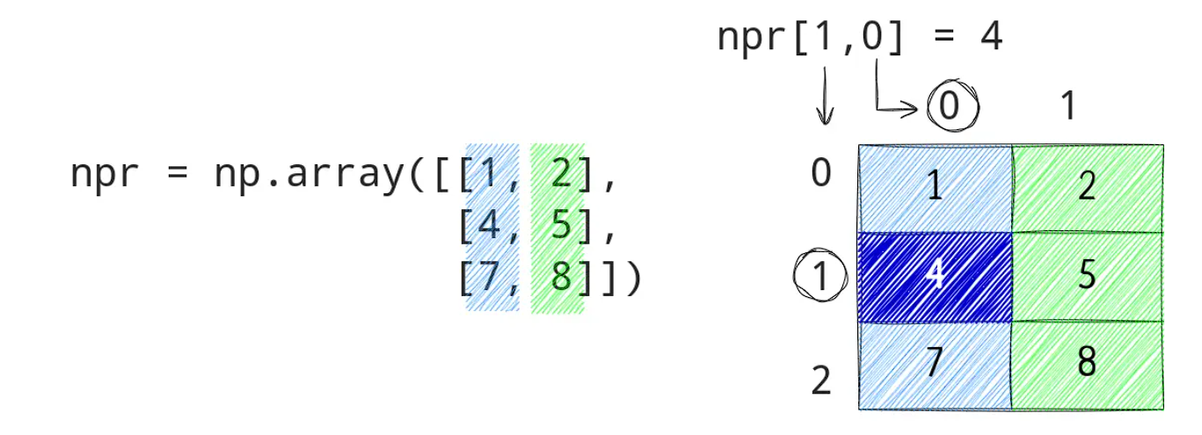
N-Dimensional Array:

Slide 14
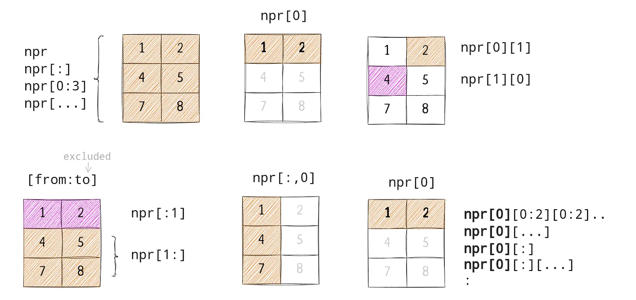
Selection:

Slide 15
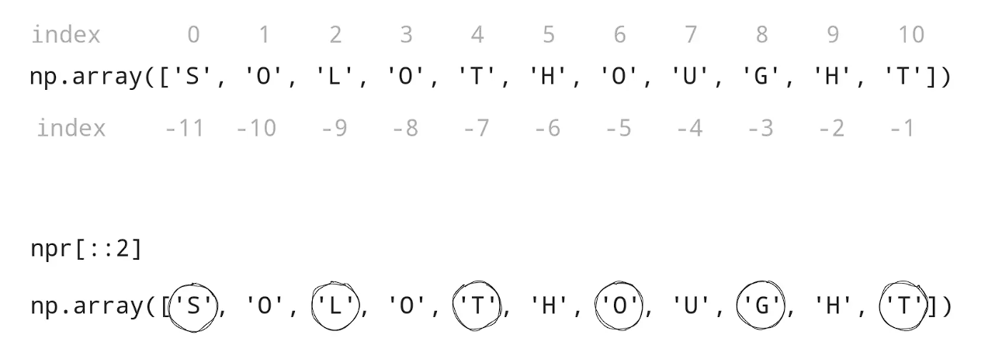
Negative Indexing and Direction:

Slide 16
Mathematical Operations:
Element-wise operations
Add, subtract, multiply, divide
Broadcasting

Slide 17
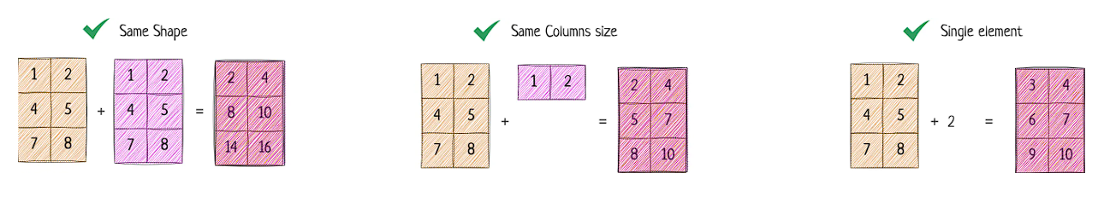
Arithmetic Operations:

Slide 18
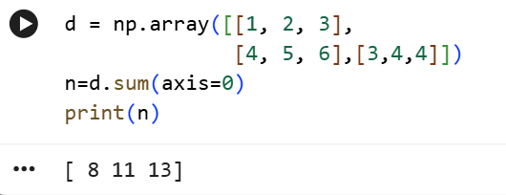
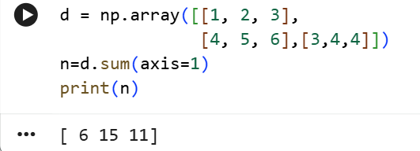
axis=0 vs axis=1
🔹 axis = 0 → Column-wise operation
👉 Works down the rows
🔹 axis = 1 → Row-wise operation
👉 Works across the columns

Slide 19
Broadcasting:
Broadcasting allows NumPy to perform arithmetic operations on arrays of different shapes.
Instead of writing loops, NumPy automatically stretches the smaller array to match the shape of the larger array.

Slide 20
Broadcasting Rules:
Compare shapes of two arrays from the trailing dimensions (rightmost first).
Two dimensions are compatible if:
They are equal, or
One of them is 1
If shapes are compatible, the array with dimension 1 is “stretched” to match the other array.
If not compatible → Error.

Slide 21
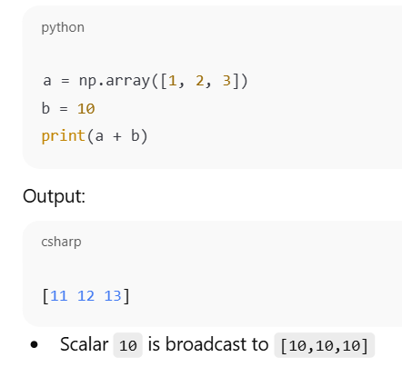
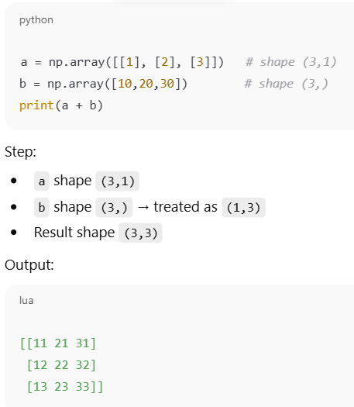

Slide 22
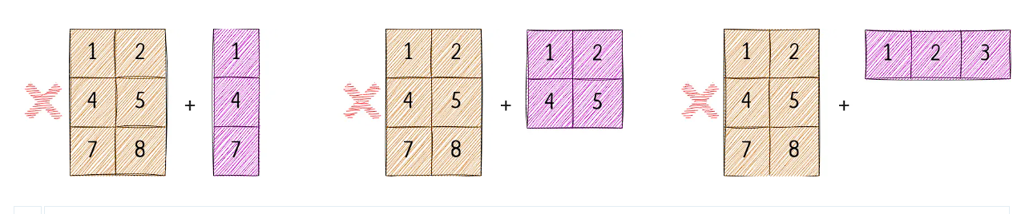
Broadcasting:

Slide 23
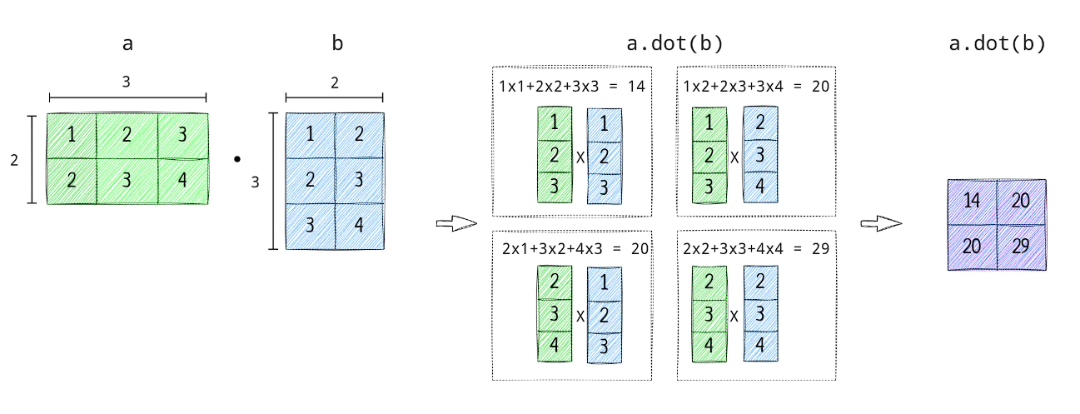
Mathematical Operations:

Slide 24
What is the output of A @ B?

Slide 25
Statistical Functions:
mean(), median()
std(), var()
min(), max(), sum()

Slide 26
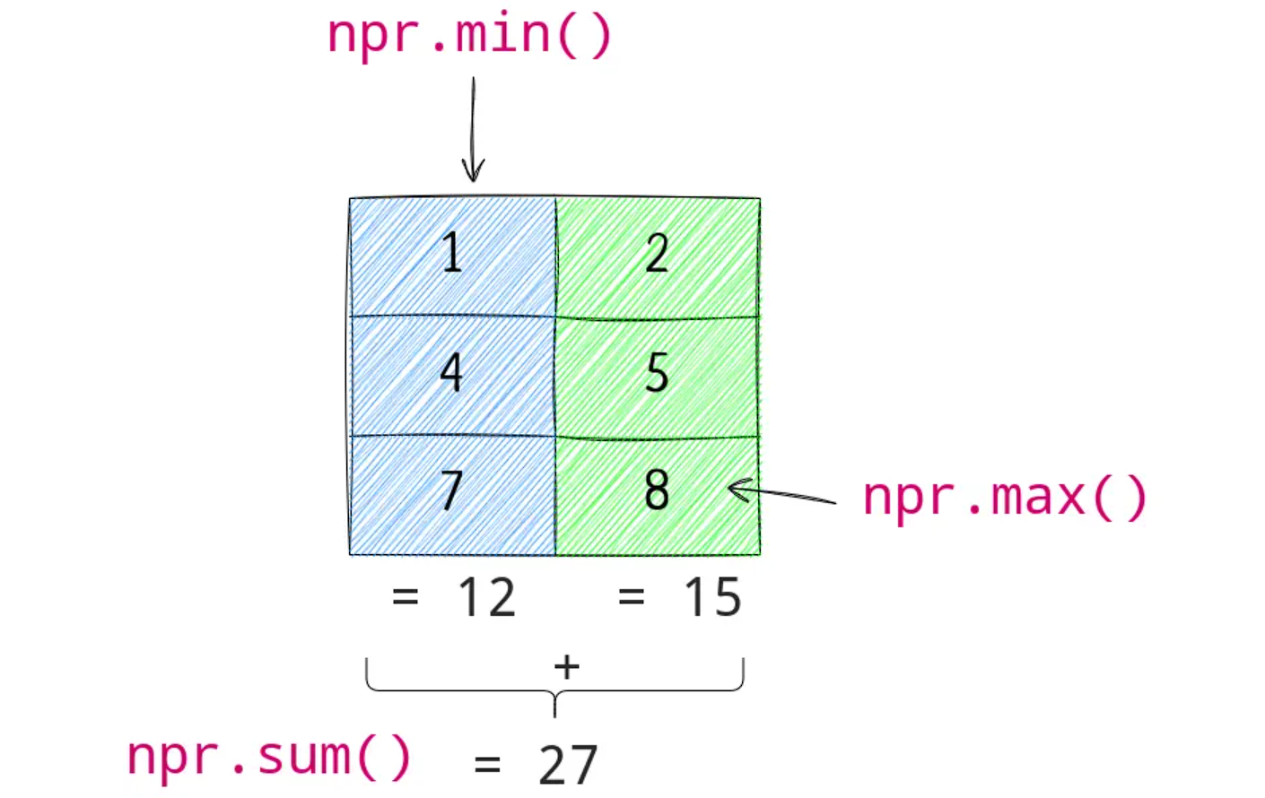
Aggregation:

Slide 27
Aggregation:
fn | Description
a.sum() | sum
a.min() | min
a.max() | max
a.cumsum() | Cumulative sum
a.mean() | Mean
a.median() | Median
a.corrcoef() | Correlation coefficient
np.std(a) | Standard deviation

Slide 28
Linear Algebra:
dot()
transpose()
inverse()
eigenvalues

Slide 29
Reshaping Arrays:
reshape()
flatten()
ravel()

Slide 30
Feature | ravel() | flatten()
Returns | View (usually) | Copy
Modifying array | Can modify original | Original unchanged
Memory usage | Less (no copy) | More (copy)
Speed | Faster | Slightly slower

Slide 31
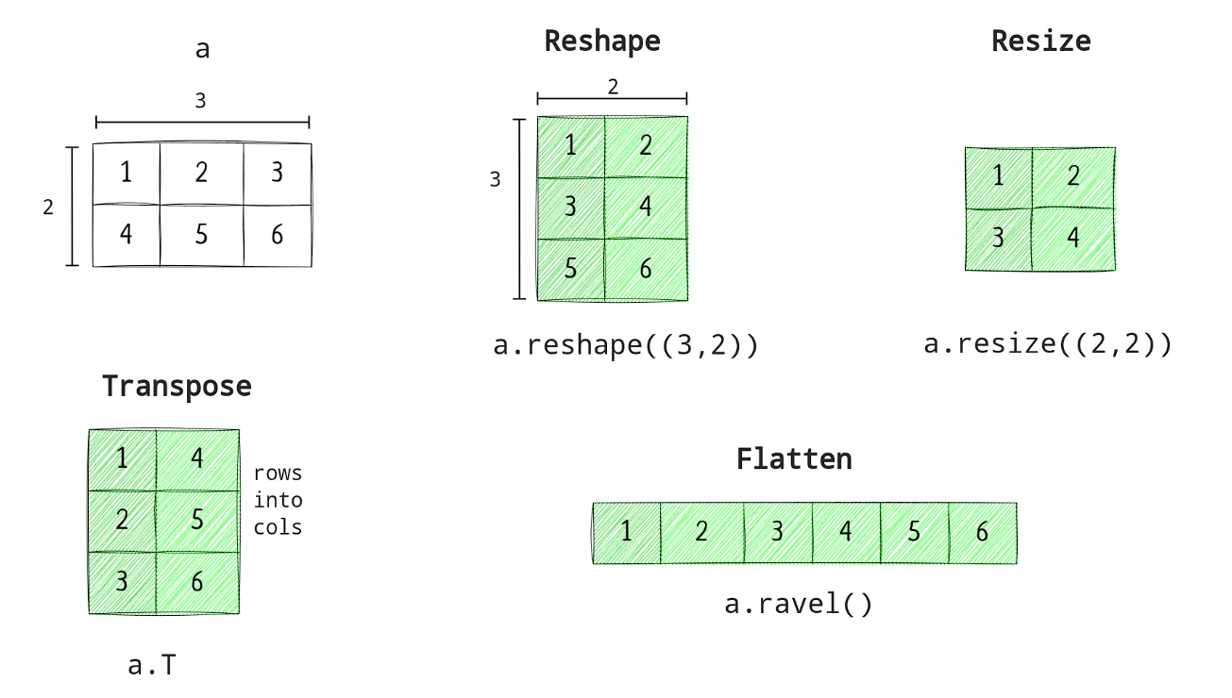
Restructuring of Array:

Slide 32
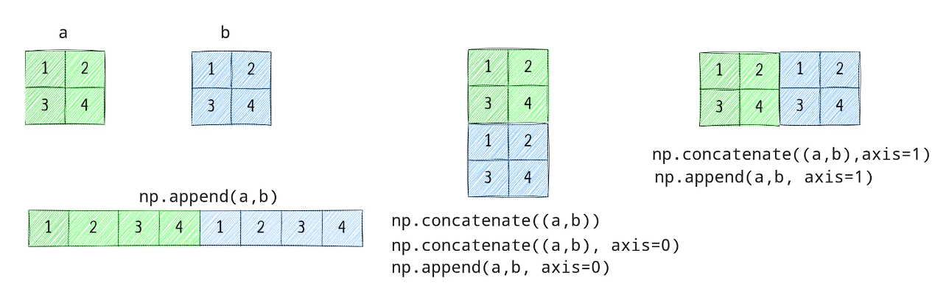
Appending and Concatenating Arrays:

Slide 33
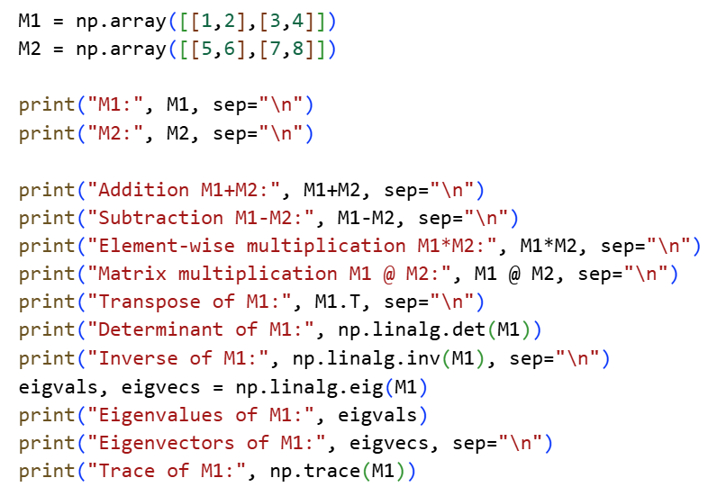
Matrix Operations:
Trace of a square matrix is the sum of all its diagonal elements (from top-left to bottom-right).

Slide 34
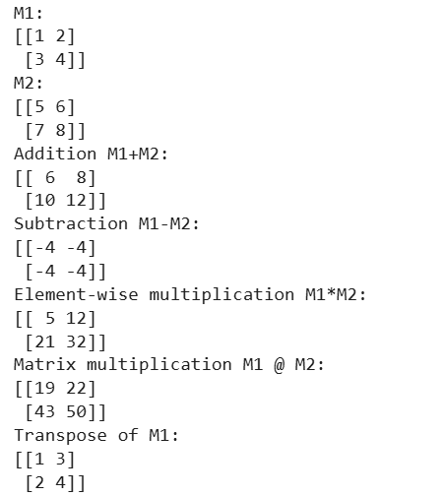
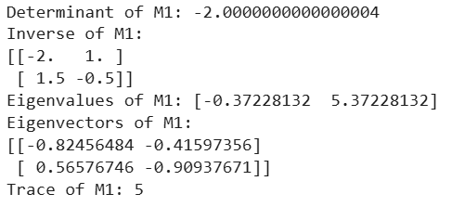

Slide 35
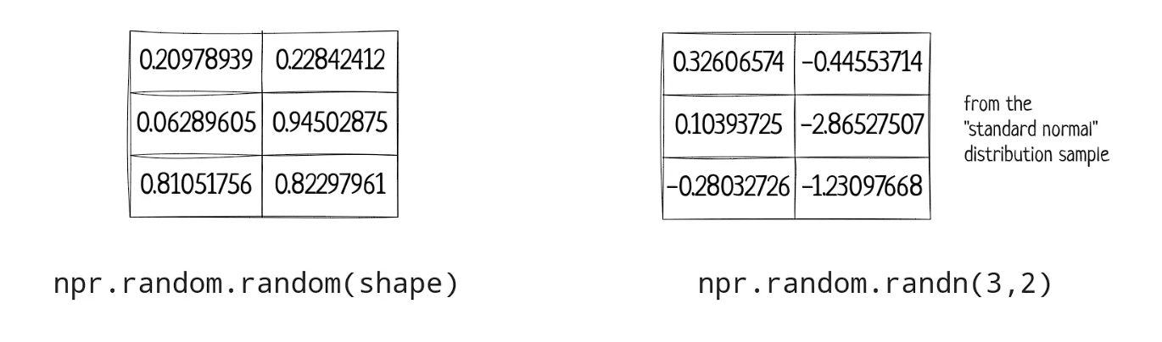

Random Module: NumPy provides numpy.random to generate random numbers and arrays.

Slide 36
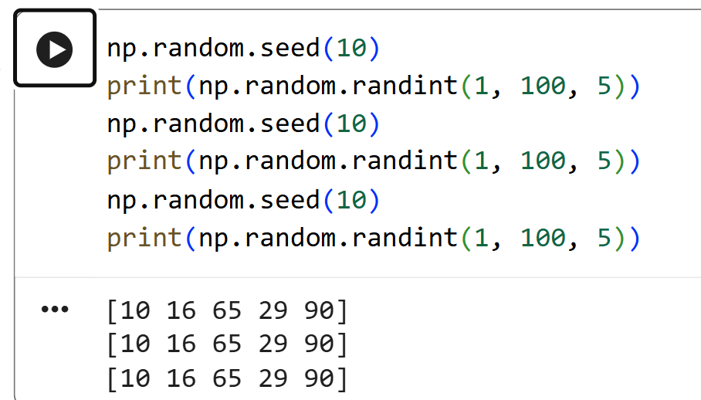

Slide 37
Task: An institute stores student exam scores for multiple subjects in a NumPy array. Each row represents a student, and each column represents a subject. Goal: Analyze the dataset using NumPy operations to support academic decisions.
Student ID | Math | Science | English | Computer
Student 1 | 78 | 85 | 90 | 88
Student 2 | 92 | 81 | 76 | 89
Student 3 | 65 | 70 | 72 | 68
Student 4 | 88 | 90 | 94 | 92
Student 5 | 55 | 60 | 58 | 62
Compute the average marks of each student using NumPy.
Calculate the average marks for each subject.
Find the total marks scored by each student.
Determine the maximum and minimum marks in the entire dataset.
Extract the marks of the 2nd student using slicing.

Slide 38
NumPy vs Python List:
Faster computation
Less memory
Vectorized operations

Slide 39
Applications of NumPy:
Machine Learning
Image Processing
Scientific Computing

